Slide 1


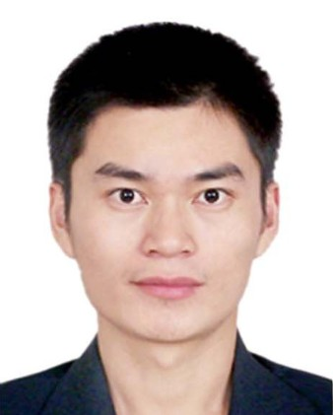

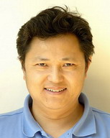
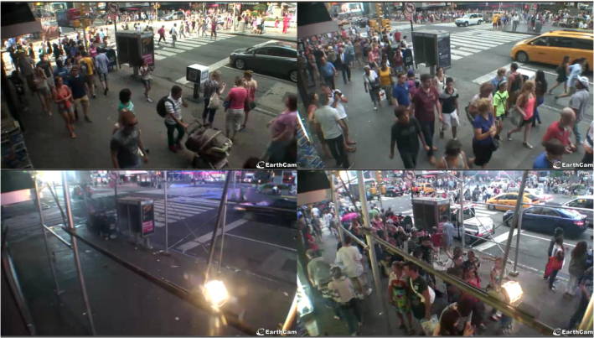
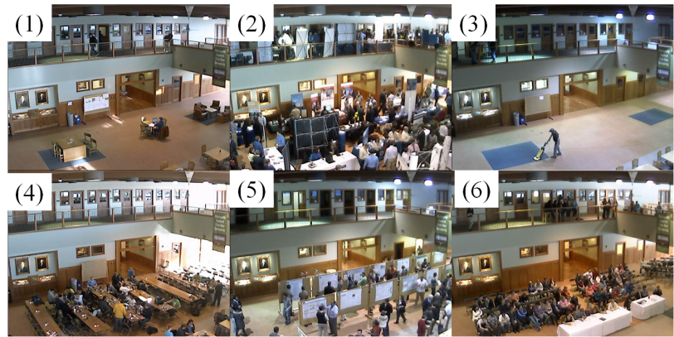
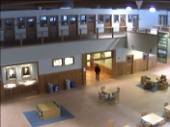
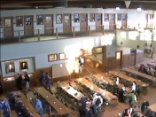


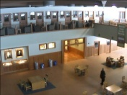
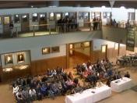


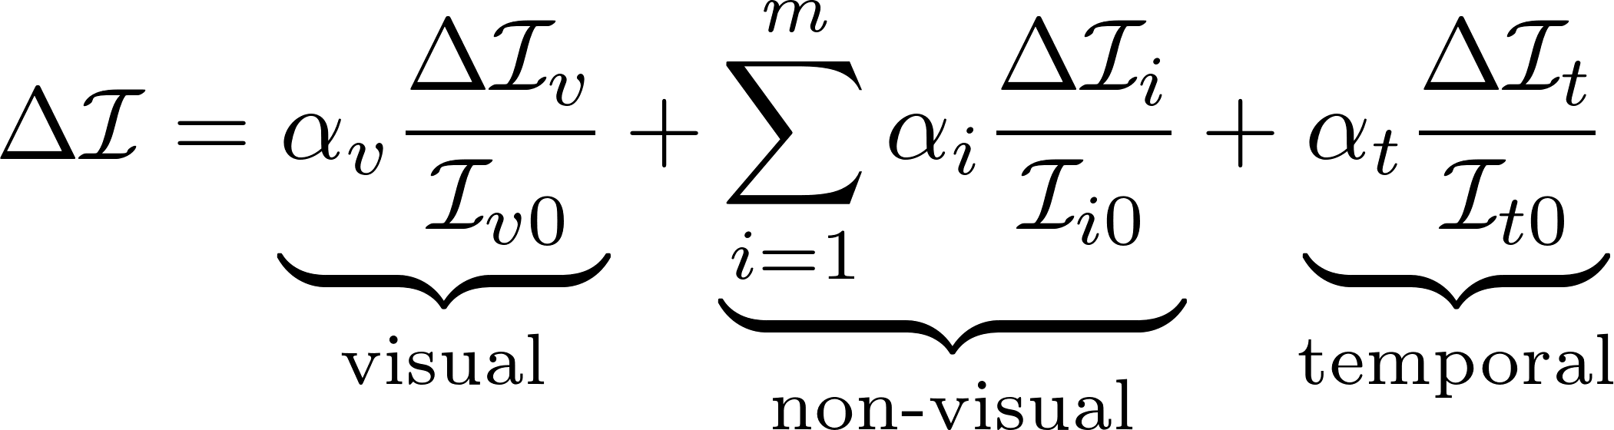
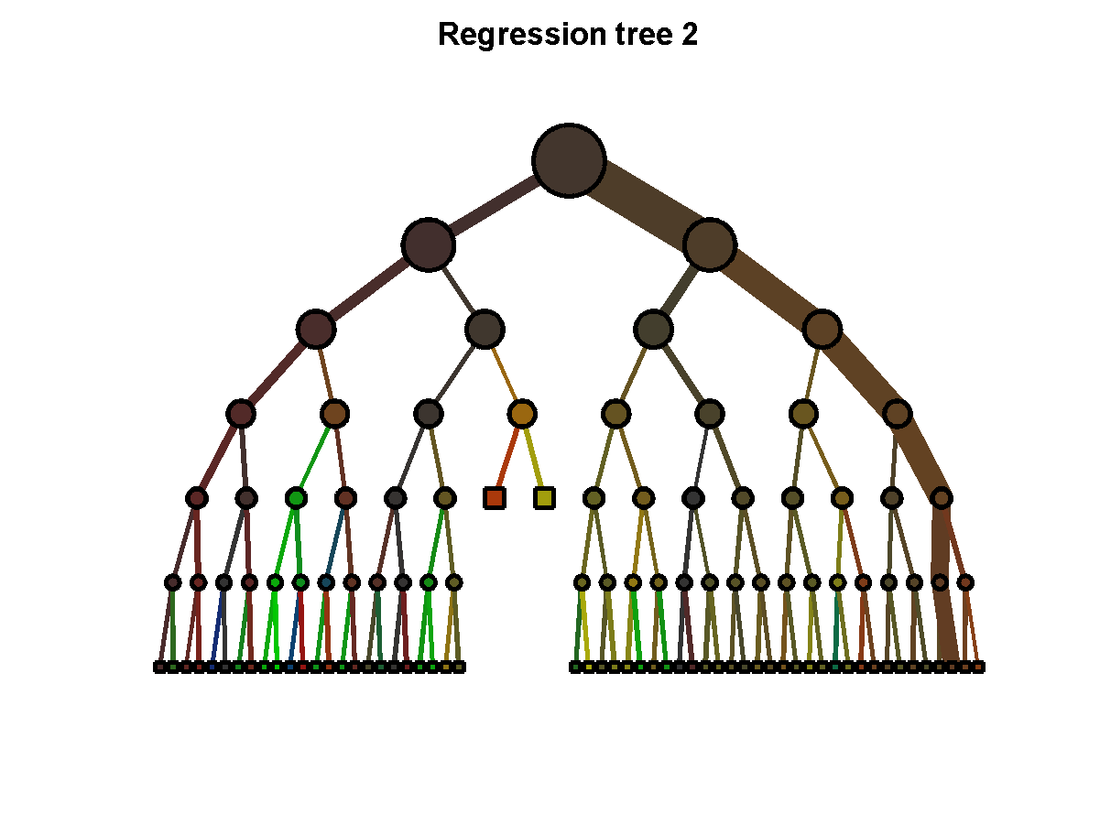
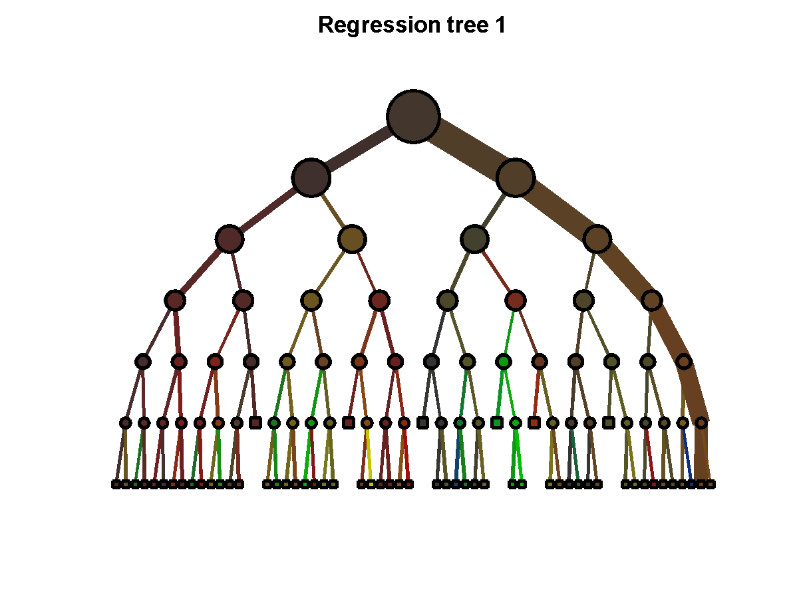

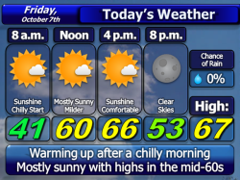
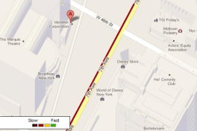





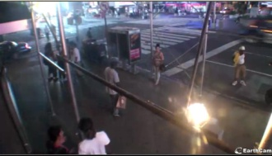


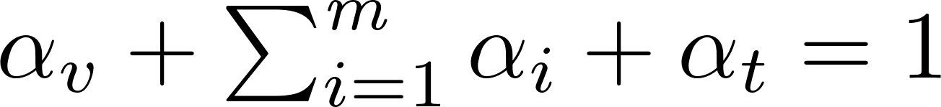
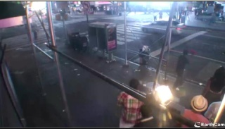
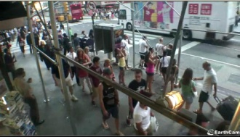

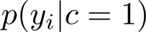
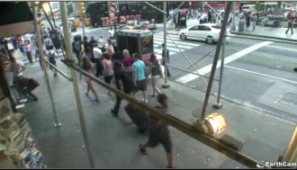

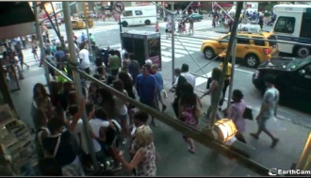
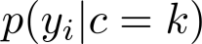
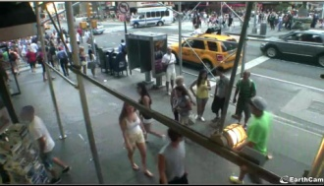
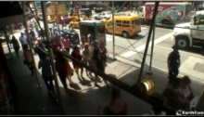
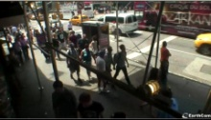
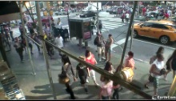


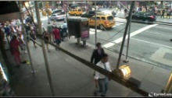

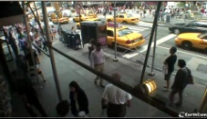


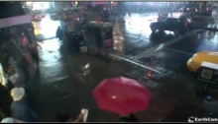
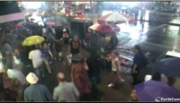

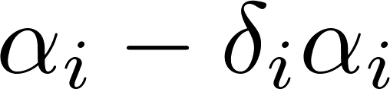


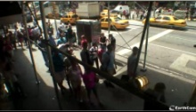
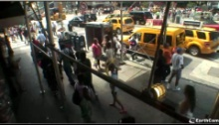
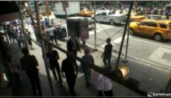

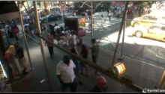
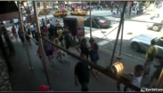

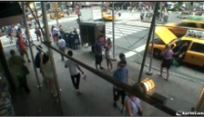
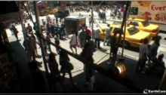
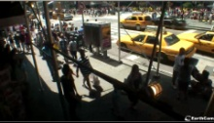

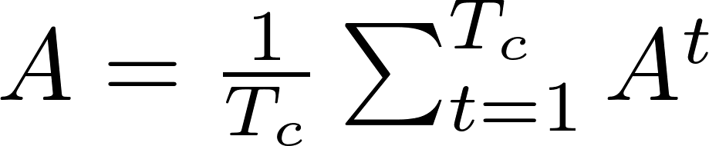


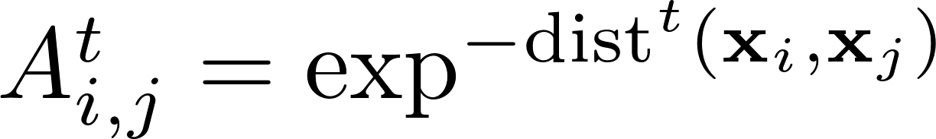
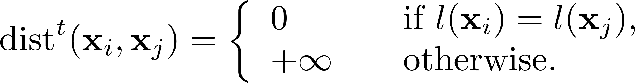
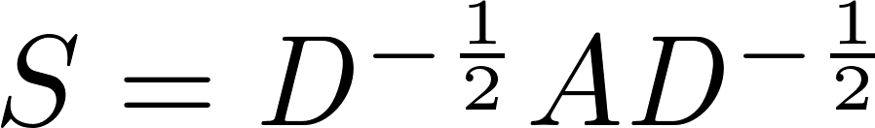

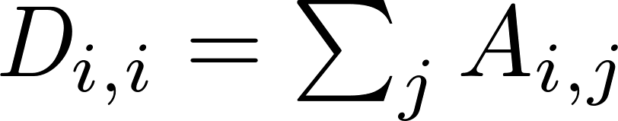
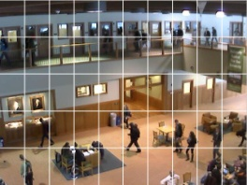


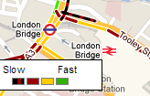



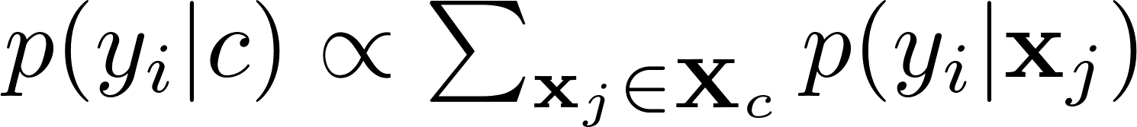






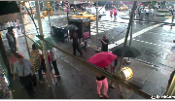
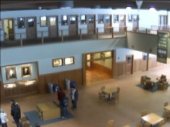
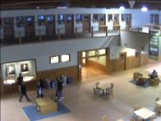
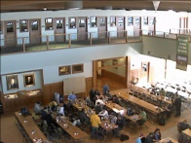



























Video Synopsis by Heterogeneous Multi-Source Correlation
Xiatian Zhu
Queen Mary, University of London xiatian.zhu@qmul.ac.uk
Chen Change Loy
The Chinese University of Hong Kong
ccloy@ie.cuhk.edu.hk
Shaogang Gong
Queen Mary, University of London sgg@eecs.qmul.ac.uk
1
Introduction
3
Learning a multi-source video synopsis model
5
Datasets
TISI
ERCe
Training a synopsis model (overview)
Step (a): Constrained Clustering Forest
(CC-Forest)
Two datasets collected from publicly available webcams: TIme Square Intersection (TISI) and Educational Resource Centre (ERCe) dataset
Input: a long video sequence
× × ×
Output: a concise semantic video synopsis
event 1 event 2 event 3
Visual Data
Non-Visual Data
(a)
Tree 1
Constrained
Clustering Forest
Tree
…
Non-visual auxiliary data:
TISI: weather, traffic speed
ERCe: campus event calendar
Student Orientation,
Career Fair,
Cleaning,
Group Studying,
Gun Forum,
Scholarship Competition.
What content is meaningful?
Affinity matrix
where
(b)
Graph
partition
: the total information gain
Weather
Traffic speed
Event calendar
: gain in individual sources
: inherent source impurity
6
Clustering evaluation
(c)
Cluster 1
Non-visual tag
distribution
Cluster
Non-visual tag
distribution
: source weights, with
Table 1. Mean entropy of cluster NV tag distribution (Red: the best)
TISI: cluster purity example – sunny (Red box: errors)
Problem:
How to generate semantic synopsis given long video streams by exploiting information beyond low-level visual features?
Dataset | TISI |  | ERCe
Method | traffic speed | weather | event
VO-Forest [1] | 0.8675 | 1.0676 | 0.0616
VNV-Kmeans | 0.9197 | 1.4994 | 1.2519
VNV-AASC [2] | 0.7217 | 0.7039 | 0.0691
VNV-CC-Forest* | 0.7262 | 0.6071 | 0.0024
VPNV10-CC-Forest* | 0.7190 | 0.6261 | 0.0024
VPNV20-CC-Forest* | 0.7283 | 0.6497 | 0.0090
Methods
Samples in a cluster
Merits of the proposed CC-Forest:
VO-Forest [1] (43/45)
Handle missing non-visual data
Joint optimisation of individual
information gain
VNV-Kmeans
(14/75)
Existing video synopsis methods:
typically rely on visual cues alone, this is inherently unreliable
difficult to bridge the semantic gap between low-level visual features and
high-level semantic content interpretation required for better summarisation
An adaptive source weighting method:
Reweight the -th non-visual source as:
with the missing ratio
VNV-AASC [2] (372/1324)
Isolate different characteristics of
different sources
VNV-CC-Forest
(58/58)
Renormalise all source weights to ensure:
VPNV10-CC-Forest
(50/73)
Accommodate partial or completely
missing non-visual data
VPNV20-CC-Forest
(29/31)
Contributions:
Generate semantic video synopsis by jointly learning heterogeneous
data sources in an unsupervised manner
Handle missing non-visual data
* Our methods; VO = visual only; VNV = visual + non-visual; VPNVxx = xx% missing ratio of the training non-visual data.
Step (b-c): Multi-Source Latent Cluster Discovery
7
Tag inference evaluation
(1) Derive a multi-source-aware affinity matrix from a learned CC-Forest:
Table 2. TISI: tag inference accuracy comparison (Red: the best)
TISI: tag inference confusion matrices comparison
Cloudy
Cloudy
Cloudy
Cloudy
Cloudy
Cloudy
Sunny
Rainy
Sunny
Sunny
Sunny
Sunny
Sunny
where is a tree-level affinity, with element defined as:
Method | VO-Forest [1] | VNV-Kmeans | VNV-AASC [2] | VNV-CC-Forest | VPNV10-CC-Forest | VPNV20-CC-Forest
traffic speed | 27.62 | 37.80 | 36.13 | 35.77 | 37.99 | 38.05
weather | 50.65 | 43.14 | 44.37 | 61.05 | 55.99 | 54.97
Rainy
Rainy
Rainy
Rainy
Rainy
with
Sunny
2
Motivation
Cloudy
(2) Symmetrically normalise the affinity matrix, obtain
Rainy
VO-Forest
VNV-Kmeans
VNV-AASC
VNV-CC-
Forest
VPNV10-CC-Forest
VPNV20-
CC-Forest
Table 3. ERCe: tag inference accuracy comparison (Red: the best)
ERCe: tag inference confusion matrices comparison
Complement
Stud. Orient.
Stud. Orient.
Accom. Service
Accom. Service
Group Studying
Group Studying
Group Studying
where denotes a diagonal matrix with elements
No Schd. Event
No Schd. Event
No Schd. Event
Gun Forum
Gun Forum
Gun Forum
Career Fair
Schlr Comp.
Career Fair
Schlr Comp.
Schlr Comp.
Weather
forecast
Event
calendar
Method | VO-Forest [1] | VNV-Kmeans | VNV-AASC [2] | VNV-CC-Forest | VPNV10-CC-Forest | VPNV20-CC-Forest
No Schd. Event | 79.48 | 87.91 | 48.51 | 55.98 | 47.96 | 55.57
Cleaning | 39.50 | 19.33 | 45.80 | 41.28 | 46.64 | 46.22
Career Fair | 94.41 | 59.38 | 79.77 | 100.0 | 100.0 | 100.0
Gun Forum | 74.82 | 44.30 | 84.93 | 83.82 | 85.29 | 85.29
Group Studying | 92.97 | 46.25 | 96.88 | 97.66 | 97.66 | 95.78
Schlr Comp. | 82.74 | 16.71 | 89.40 | 99.46 | 99.73 | 99.59
Accom. Service | 00.00 | 00.00 | 21.15 | 37.26 | 37.26 | 37.02
Stud. Orient. | 60.94 | 9.77 | 38.87 | 88.09 | 92.38 | 88.09
Average | 65.61 | 35.45 | 63.16 | 75.69 | 75.87 | 75.95
Career Fair
Accom. Service
Sensor-based
traffic data
(3) Perform spectral clustering [3] on , with automatically estimated cluster number
Cleaning
Cleaning
Cleaning
Stud. Orient.
Each training sample is then assigned to a cluster
No Schd. Event
Cleaning
Career Fair
(4) Predict a unique distribution of each non-visual data for a cluster
Gun Forum
Group Studying
Schlr Comp.
where refers to the training sample set in
Accom. Service
Stud. Orient.
VO-Forest [1]
VNV-Kmeans
VNV-AASC [2]
No Schd. Event
Cleaning
Structure-driven tag inference
Career Fair
Visual Features
Non-Visual Auxiliary Data
4
Gun Forum
Group Studying
Schlr Comp.
Accom. Service
Tree 1
…
Tree
Infer non-visual tag of a test sample
Stud. Orient.
VNV-CC-Forest
VPNV10-CC-Forest
VPNV20-CC-Forest
Capture the common physical phenomenon,
thus intrinsically correlated
(a)
Step (a): trace the target leaf of tree
- search for the leaf of each tree
falls into
8
Semantic video synopsis
Day 1
Day 2
Stud. Orient.
Group Studying
W = Cloudy, T = Fast
W = Sunny, T = Slow
W = Cloudy, T = Fast
W = Sunny, T = Slow
01-09
01-27
06am
10am
06am
10am
Leaves
Step (b): retrieve leaf level clusters
- derived from training samples
sharing the same leaf node
- search for nearest clusters
whose tag distribution is used
as tree-level prediction
W = Sunny, T = Slow
W = Cloudy, T = V.Slow
W = Sunny, T = Slow
W = Cloudy, T = Slow
13pm
16pm
11am
16pm
Day 6
17pm
22pm
Day 3
17pm
19pm
W = Cloudy, T = Fast
W = Cloudy, T = Slow
W = Cloudy, T = Fast
W = Sunny, T = Slow
Schlr. Comp.
Career Fair
Non-trivial problem that requires joint learning to discover latent associations between heterogeneous multiple data sources:
Heteroscedasticity problem, e.g. very different representations
Individual data sources can be inaccurate and incomplete
Non-visual data is not always available, nor synchronised with visual data
(b)
06am
11am
…
06am
10am
03-01
02-07
W = Sunny, T = Slow
W = Cloudy, T = V.Slow
W = Cloudy,T = Slow
W = Cloudy,T = V.Slow
13pm
15pm
10am
14pm
16pm
22pm
16pm
22pm
Nearest Clusters
Step (c): average tree-level predictions
- yield a smooth prediction
TISI: A synopsis of weather+trafﬁc changes
ERCe: summarisation of some key events
(c)
9
Source association
Visual-Visual
Vehicle detection and traffic speed
Tag Distribution
person detection in regions 1-16
TISI: discovered latent correlations among visual and non-visual sources
[1] L. Breiman. Random forests. ML, 2001
[2] H.-C. Huang, Y.-Y. Chuang, C.-S. Chen. Afﬁnity aggregation for spectral clustering. CVPR, 2012
[3] L. Zelnik-manor and P. Perona. Self-tuning spectral clustering. NIPS, 2004
Project page:
http://www.eecs.qmul.ac.uk/~xz303/
vehicle detection in regions 1-16

